Slide 1
TMDSAS Application PROCESs
Texas Medical and Dental School Application Services

Slide 3
The Application

Slide 5
Early Decision
Texas Tech – Texas residents only
UNT – Residents and non-residents
Rio Grande – Only for residents of the Rio Grade Valley
If you select an EDP school, you must submit primary and secondary application by August 1st and all other materials by Sept 15th
Obligated to attend if accepted

Slide 6
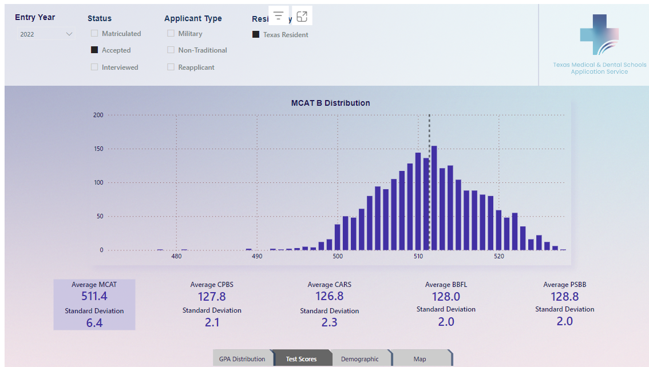

Slide 7
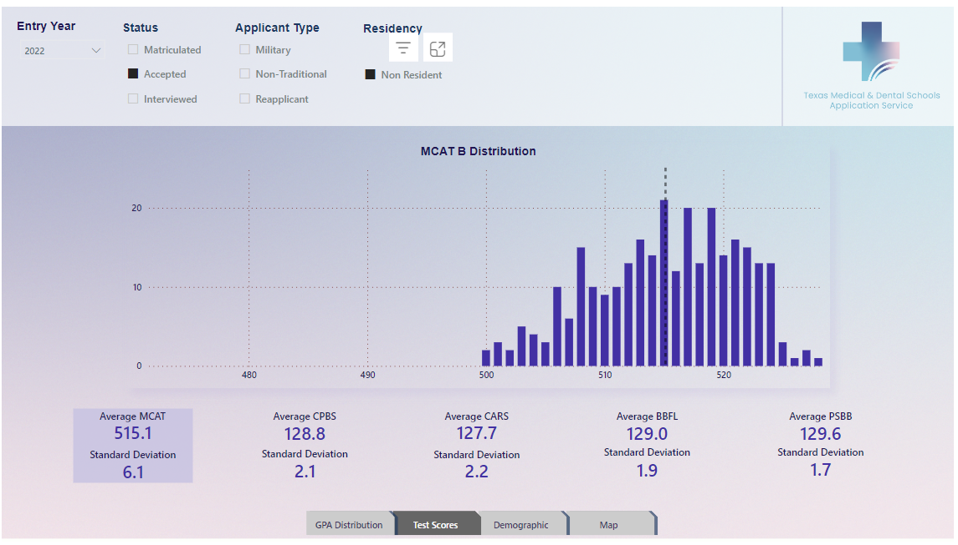

Slide 8
Residency

Slide 12
Release of Information – “yes”

Slide 13
Under ‘Education History’
If this happens after you’ve submitted, you must notify TMDSAS and each med school within 10 business days.

Slide 14
HP Committee Packet

Slide 15
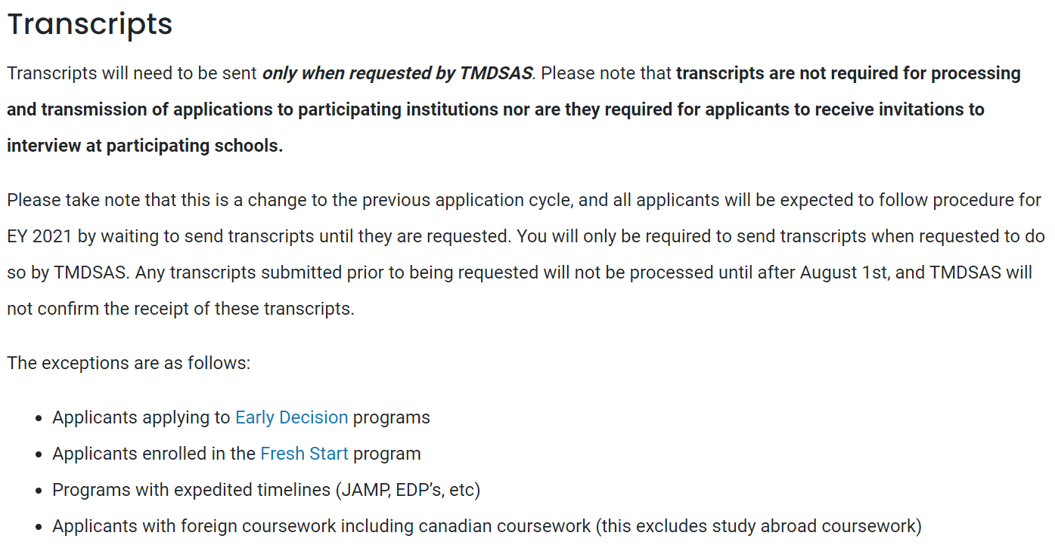
Transcripts?

Slide 16
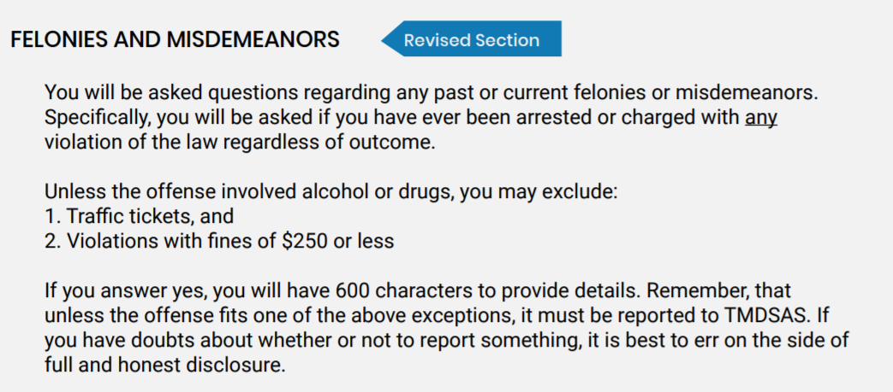
Don’t report traffic tickets

Slide 17
Chronology

Slide 18
TMDSAS
EY 2024 opens May 1st, 2023 at 8:00am
$215 flat fee
Verification CAN begin without letters, transcripts, or MCAT scores

Slide 19
Caroline’s Timeline
MCAT—May 25th, 2019
Requested ALL Transcripts for TMDSAS and AMCAS—May 29th, 2019
PMAC Submitted—June 7th, 2019
PMAC Interview—June 17th, 2019
AMCAS Submitted—June 19th, 2019
MCAT Results—June 25th, 2019
TMDSAS Submitted—June 29th, 2019
TMDSAS PROCESSED—July 15th, 2019
AMCAS Processed—July 16th, 2019
Secondaries completed as they came in…
Texas Interview—August 9th, 2019
UCF Interview—September 13th, 2019
UAMS Interview—October 5th, 2019
Texas Acceptance—October 15th, 2019
SLU Interview—November 4th, 2019
Texas Interview—November 15th, 2019
Scheduled TX Interview—December 1st, 2019
SLU Acceptance—January 21st, 2020
UAMS Acceptance—January 24th, 2020

Slide 20
Safee’s timeline
Started studying January 17th
Asked for letters of recommendations late March-April
Took MCAT April 21st
Took one week off post MCAT then started writing personal statement and completed PMAC application
Started working on TMDSAS middle of May
Completed PMAC late May
Submitted TMDSAS June 25th
Finished all secondaries by August 1st
Interviewed August-October

Slide 21
Secondary
An opportunity to distinguish yourself
All are essay questions except Dell Medical
Some are free some cost money ($50-$100)
Look up the school's mission statement and values

Slide 22
INTERVIEW
Interview offers are started to be extended July-October
You can pick normally 1 of 4 dates for your interview
Cost of travel are not covered
Most school have an optional dinner the night before
Individual interview, MMI, group interview
Interview days are also for YOU, you get an opportunity to meet students/faculty/learn about the school
TAKE NOTES!

Slide 23
Pre-match
Was November 15th, now listed as TBD
Can hold onto multiple offers

Slide 24
Match day !!!!!
Rank ALL the schools you interview at
Date TBD, probably Mar 1st
The schools have a list and send that to TMDSAS
You will “match” with ONE school
The highest one on your list that accepted you
This is so everyone possible can get accepted and not hold onto multiple offers causing others to be waitlisted

