Slide 1
Applying to Med School Part 2 AMCAS EY2024
April 2023

Slide 2
2024 AMCAS Participation
Tentative 2024 Participation
Application | 153 Schools/Programs All MD granting schools in the United States with the exception of MD programs at Texas public schools
AMCAS Letters | 151 Schools/Programs
Criminal Background Checks | 127 Schools/Programs
2024 AMCAS Application Fees:
$175 processing fee (includes one school designation)
$45 for each additional school
aamc.org/amcas

Slide 3
2024 Application Dates
Date* | Event
April 3 | 2024 AMCAS resources available
May 2 | AMCAS application opens
May 30 | AMCAS application submission begins
June 30 | Initial transmission of application data to medical schools
August 1 | Early Decision Program deadline
Sept.-Dec. | Application deadlines
Application Deadlines
Application must be submitted by 11:59 p.m. ET of the deadline date
Transcript deadlines must be received by AMCAS within 14 calendar days of the application deadline date
Must be received by August 1 for early decision applicants
Visit www.aamc.org/amcasdeadlines
*Dates subject to change

Slide 4
The AMCAS Application
1. Identifying Information
6. Letters of Evaluation
7. Medical Schools
2. Schools
Attended
5. Work and
Activities
8. Essays
9.
Standardized Tests
3. Biographic
Information
4.Coursework

Slide 5
2024 AMCAS Application Changes
New Experience Type
“Social Justice/Advocacy” in the AMCAS Web App Work/Activities section
Biographic Information
“Other Impactful Experiences” is replacing the self-reported “Disadvantaged Status” question, including new help text
Institutional Actions
“Conduct” and/or “Academic” filters as a dropdown within the existing Institutional Action question
Preview™ Exam
An optional field to indicate an upcoming Preview™ exam and the date of the exam
Pronoun & Gender Identity
Update to the “Other” labels for Pronoun and Gender Identity
Help Texts
Update to Essay prompts and Certification statement

Slide 6
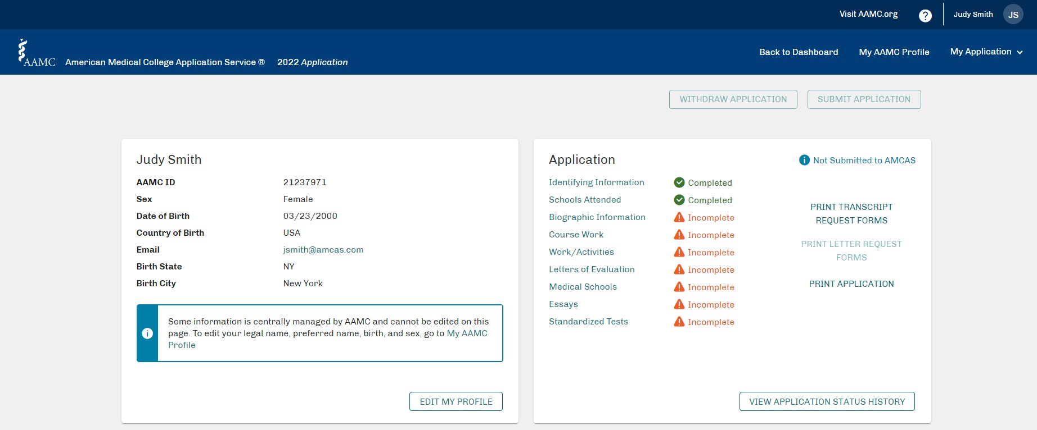
AMCAS Main Menu

Slide 7
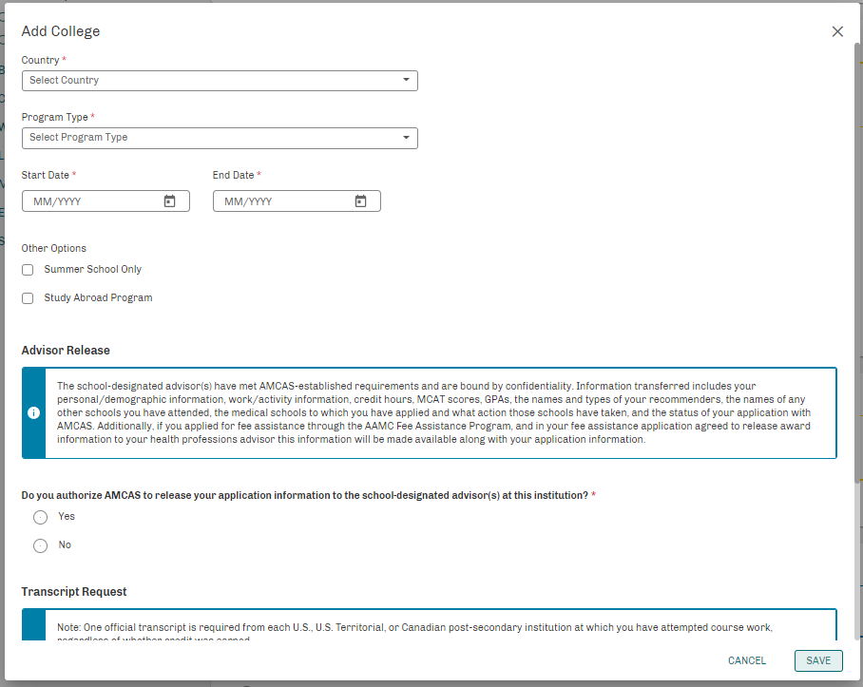
Schools Attended

Slide 8
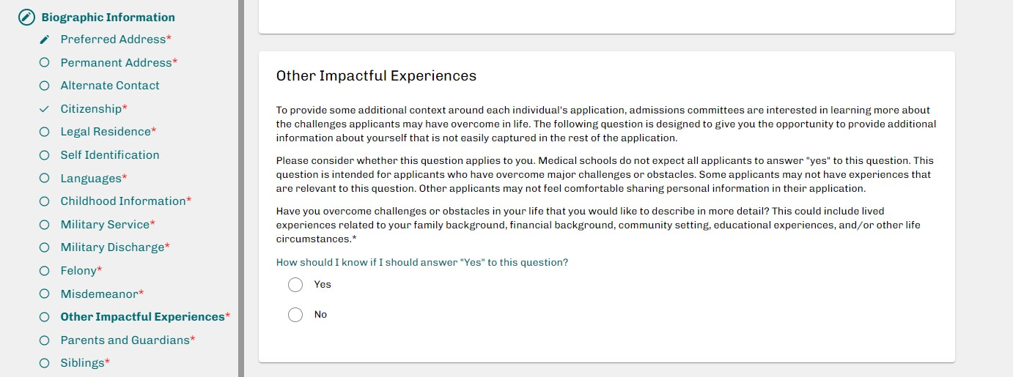
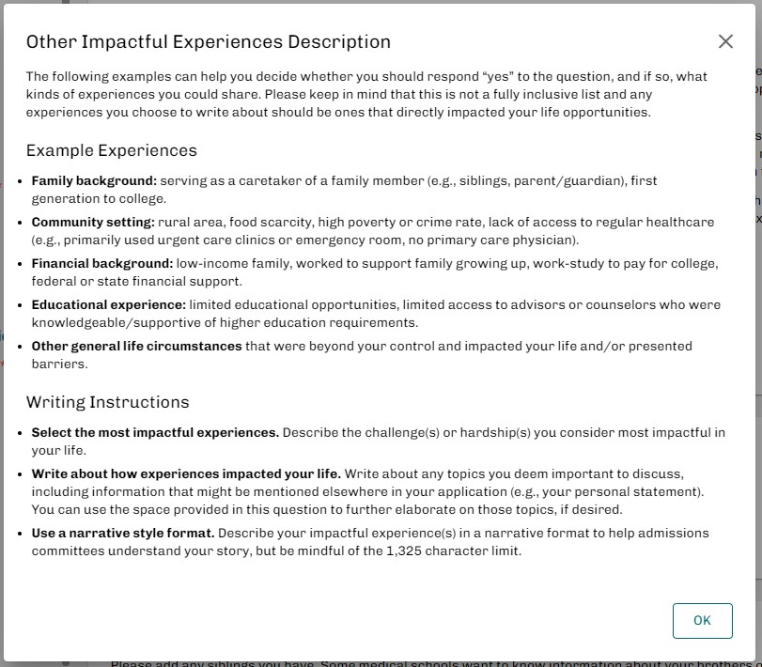
Other Impactful Experiences

Slide 9
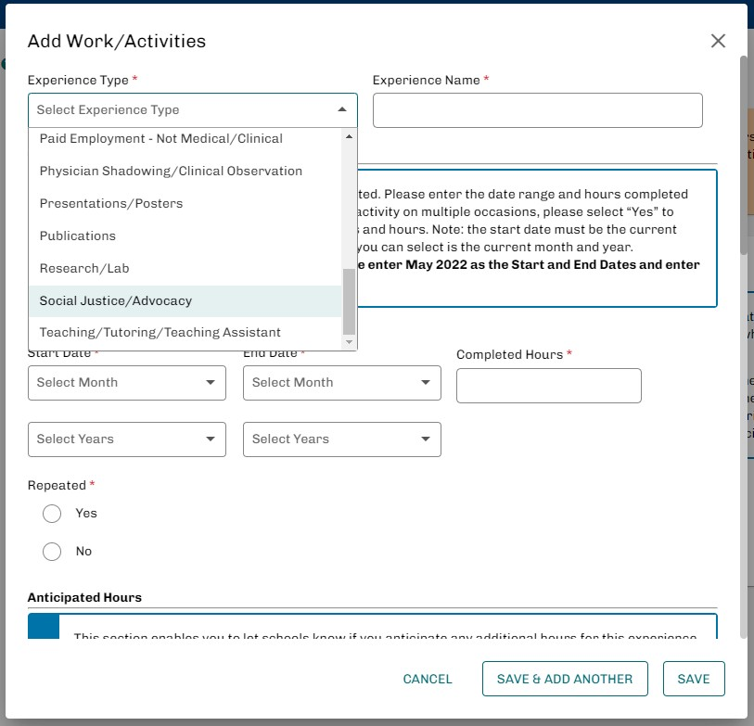
Work/Activities

Slide 10
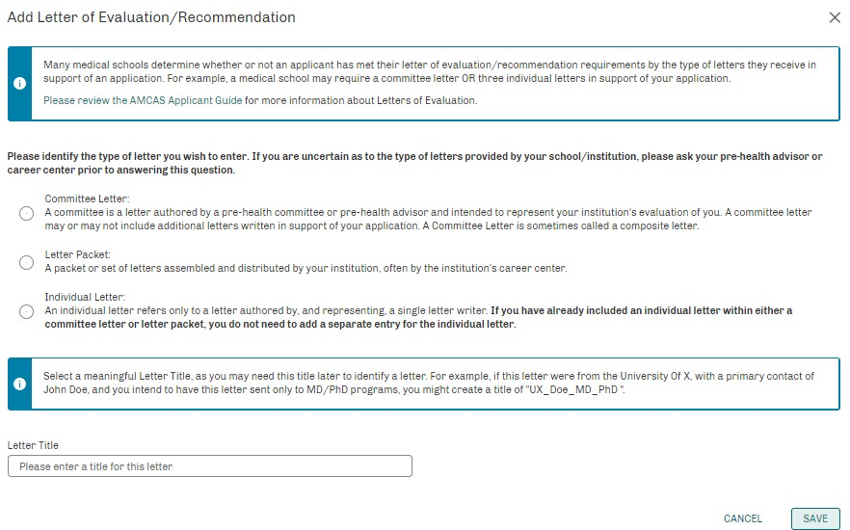
Letters of Evaluation
Applicants can submit their application before AMCAS receives their letters.

Slide 11
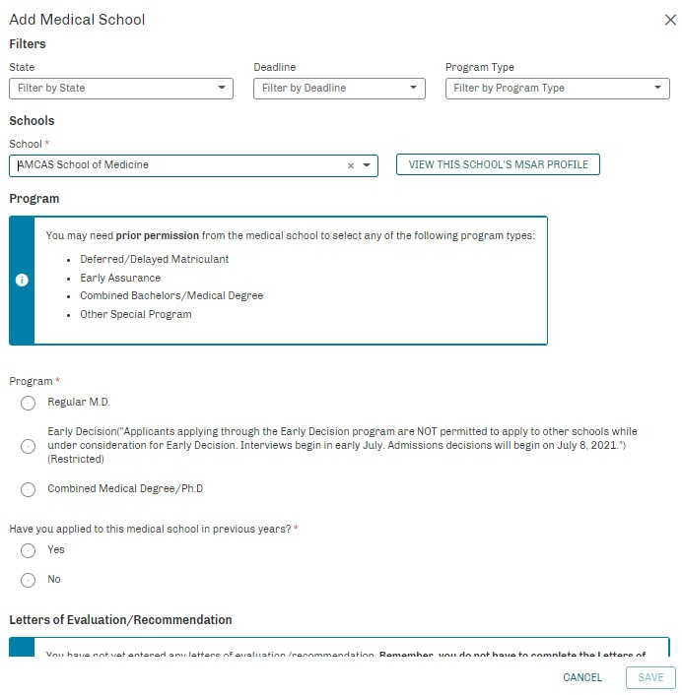
Medical Schools

Slide 12
AMCAS Verification Process
Transcripts
All required official transcripts must be received before an application can join the verification queue
Application Submitted
All official transcripts received
Processing
From date of “Ready to Review” application status, about 6 weeks
Find processing on the AMCAS application sign in page
“Ready for Review” Status
Verification Queue

Slide 13
AMCAS Verification
Average number of business days to complete verification
30
25
21
18
2023AY
2022AY
2021AY
2020AY
14
8
9
4
3
2
0
2
1
June
July Aug
Sept
Oct
Nov
Dec

Slide 14
Letters of Evaluation
Letters of Evaluation Received, 2019AY – 2023AY
70000
60000
50000
40000
30000
20000
10000
0
August September 2019 2020 2021 2022 2023
May
June
July
October
November
December

Slide 15
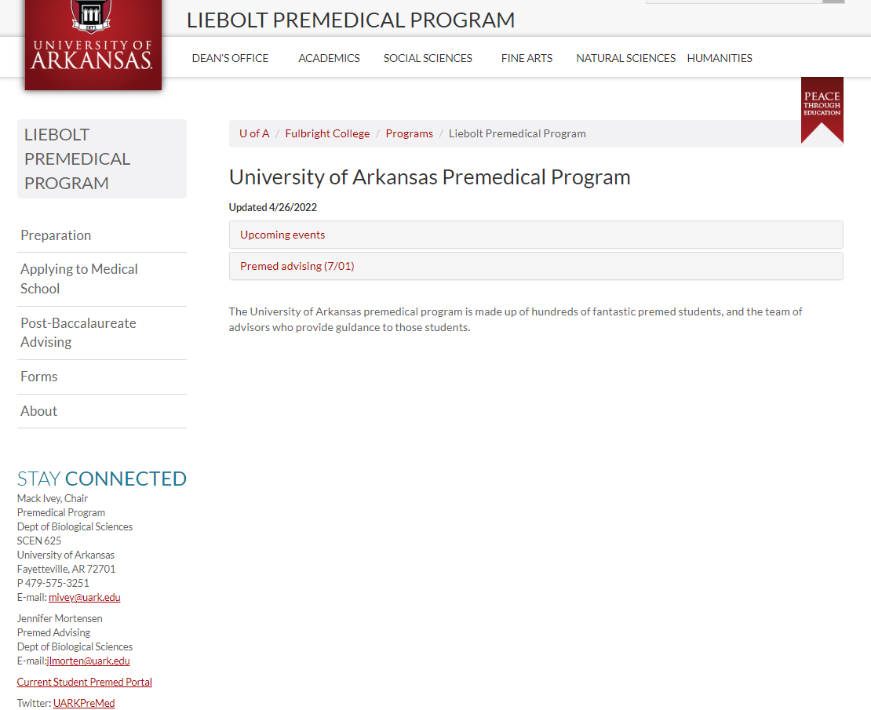
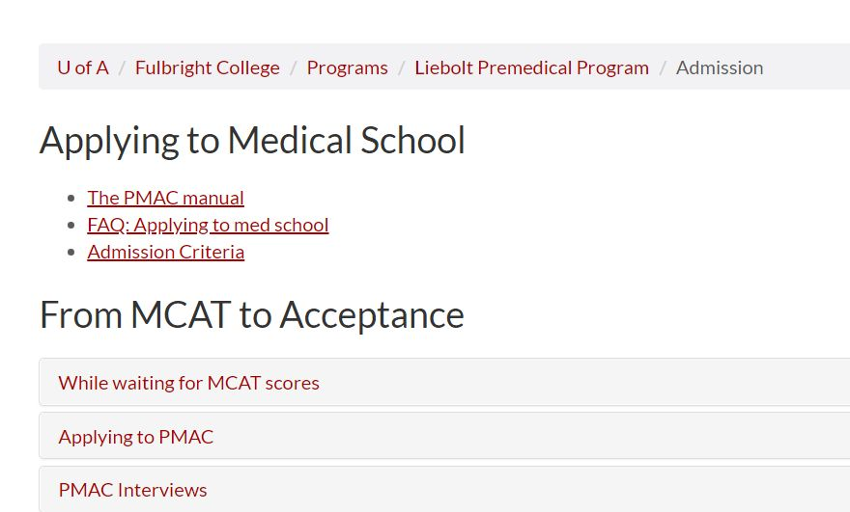
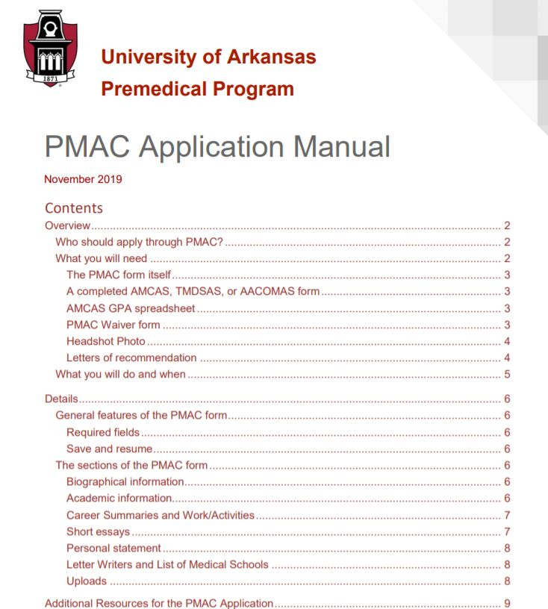
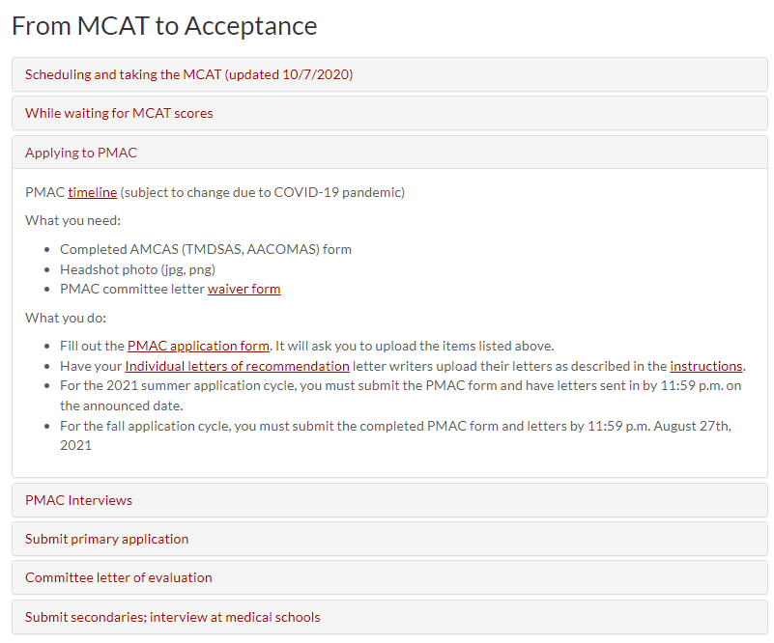
The PMAC Application

Slide 16
Transcript Requests
How exactly do I use the AMCAS (or TMDSAS) request form to get transcripts sent from the UofA?
You first fill out the AMCAS/TMDSAS request form, and then deliver it to the Registrar (Silas Hunt) either in person or online. If in person, make it clear that they need to include the AMCAS/TMDSAS forms along with the transcripts when they mail them out.
If you’re not on campus, you can request transcripts through UAConnect and email the AMCAS/TMDSAS form to registra@uark.edu.

